Slide 1
Team Theta Project Report
Oasis Sales Software Exploratory Analysis
Project Presentation
CS504 Team Project
Fall 2020

Slide 2




Team Theta Organization
&
Tools
GitHub as our development resource to preserve code
YouTrack to determine Sprint progressions
Google Drive for collaboration and file storage
RapidMiner, Python, and R to complete modelling and statistical analysis
Business Goals:
Create a prediction method for product release date and provide the best indicators for release date
Find the most accurate current predictor for the dataset
Joe Ciampi
Developer
Lorenzo Rollhauser
Developer

Slide 3
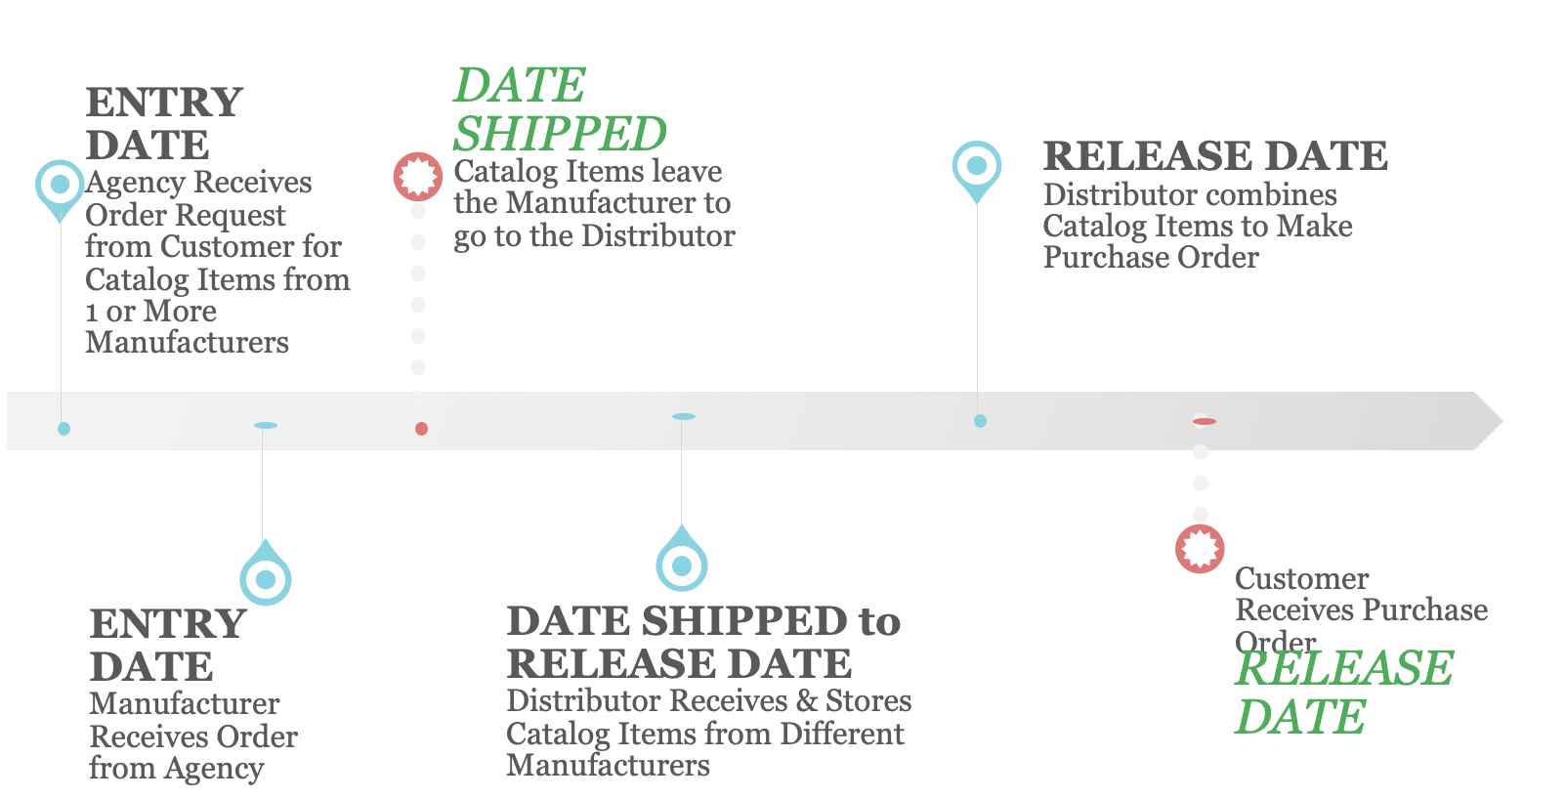
Problem Statement
Using the Oasis Sales dataset from Ingen software, our team intends to determine which variables are the best indicators for the release of products and furthermore create a model which is able to predict the release date.

Slide 4
Assumptions
Assumptions
Risks
Manufacturer, Distributor and Customer location: Denver
CDC guidelines regarding COVID-19 are followed
Trucks delivering orders to job sites use diesel
Orders are entered, shipped, then released
Anonymity in the report
Null values excluded
COVID-19 provisional data
Criteria for judging accuracy of predictions
Use of different applications or algorithms
Notes:
Customer tolerance is 0-1 days for purchase orders arriving early or late to job sites.
Manufacturer and shipping location: Denver
All parts of a purchase order arrive on the same day.
Null values in the datasets are not useful for analysis.
CDC guidelines regarding COVID-19 are followed by all parties involved
Trucks delivering purchase orders to job sites use diesel fuel.
Orders are entered, then shipped, then released.
Daily gas prices assumed using weekly gas prices and interpolation.
The dataset provided to the team is by a private company, so their anonymity must be retained in the report.
The weather, gas prices, COVID-19, and private company’s datasets all contained null values that were not able to be attained.
The COVID-19 data provides provisional data which could potentially be a risk due to dealing with negative numbers
The descriptive statistics summary could return multiple values that could be used to determine which entity (the Agency, Factory, or Ingen Software) had the most accurate predictions for the release date of purchase orders in the Oasis Sales Software dataset.
The use of different applications or algorithms to analyze could result in different outcomes for the accuracy of predictions.

Slide 5



Data Sources
Oasis
Diesel Gas
Weather
Covid-19

Slide 6

Research
Analytics and Algorithms
Datasets
01
Linear / Multivariable Regression
Determines the relationship between linearly related variables
Residuals determine the validity of assumptions
Coronavirus Dataset
02
Moving Average
Useful for forecasting long term trends
Builds average based on previous data points to help create interpolations
Oasis Sales Software Predictions
03
Exponential Smoothing
More advanced moving average that assigns weights to data points
Developing forecasts based on past observations
Weather Dataset
Gas Dataset
04
Cleaning unorganized unstructured or structured data
Helps make data more accessible
Classification
05
Gradient Boosted Tree Algorithm
Works by creating branching decision trees
Used to build predictions through regression and classification

Slide 7
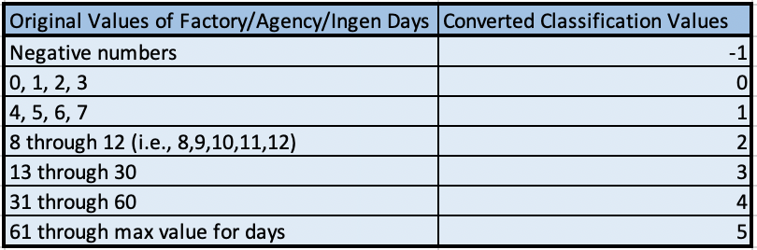
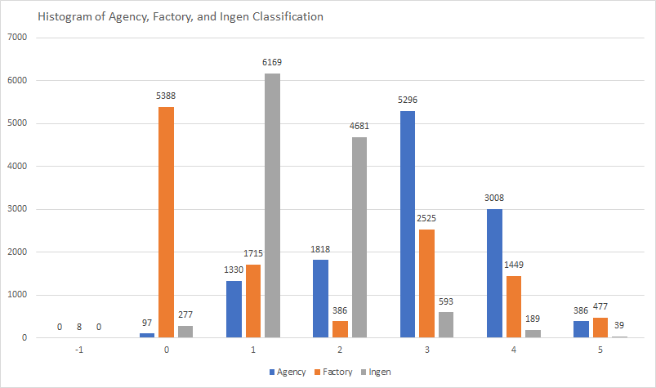
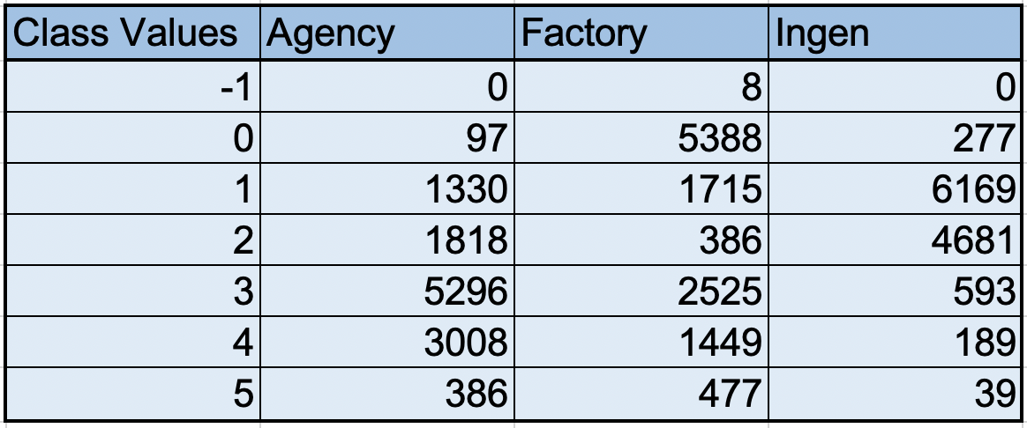
Visualizations
Agency, Factory, Ingen Days Class Conversions
Table of Histogram Values

Slide 8
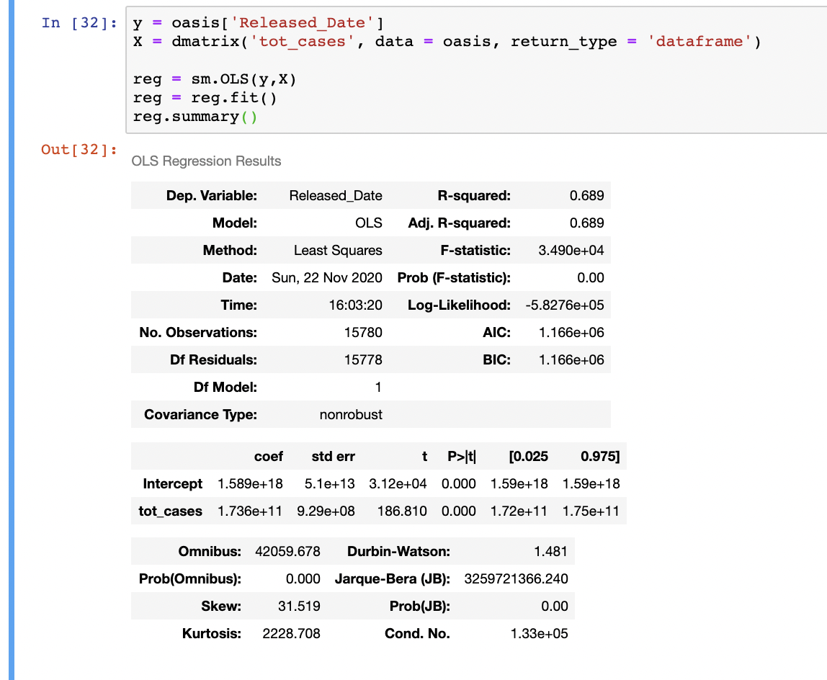
Correlation and Regression Summary
Regression Analysis (Release Date and Total Covid Cases)
Correlation Table (Summary)
Gas Prices and Total Covid | Strong Negative, R=-0.42
Release Date and New Covid Deaths | Negative, R=-0.35
Release Date and Total Covid Deaths | Strong Positive, R=0.83
Precipitation, Snow and Release Date | No Correlation, R=-0.07, 0.14
Gas Prices and Release Date | No Correlation, R=-0.03
Resell Item and Release Date | Very Weak Positive, R=0.1

Slide 9
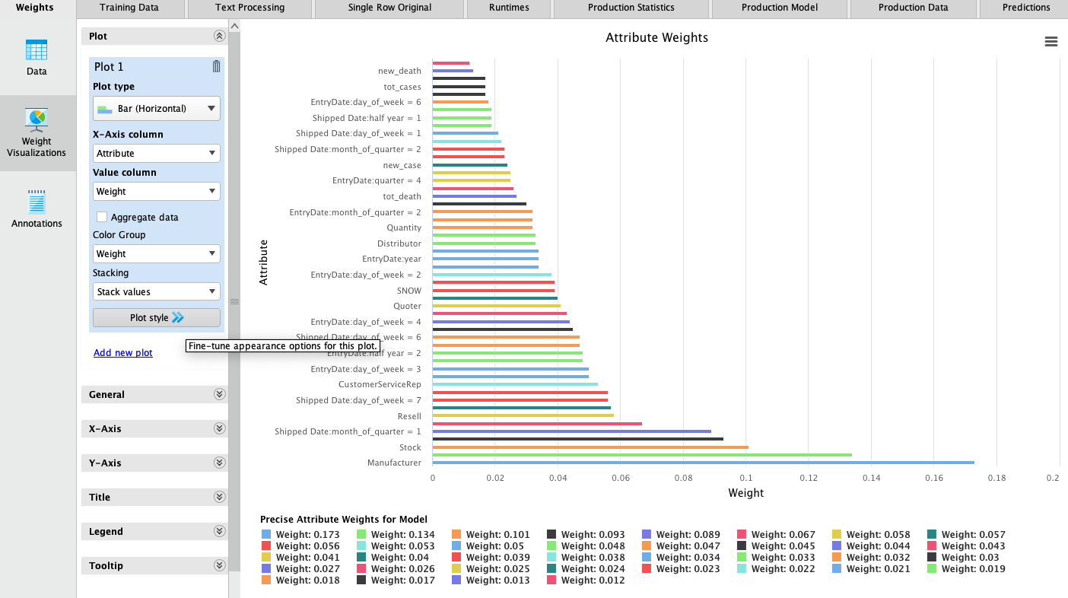
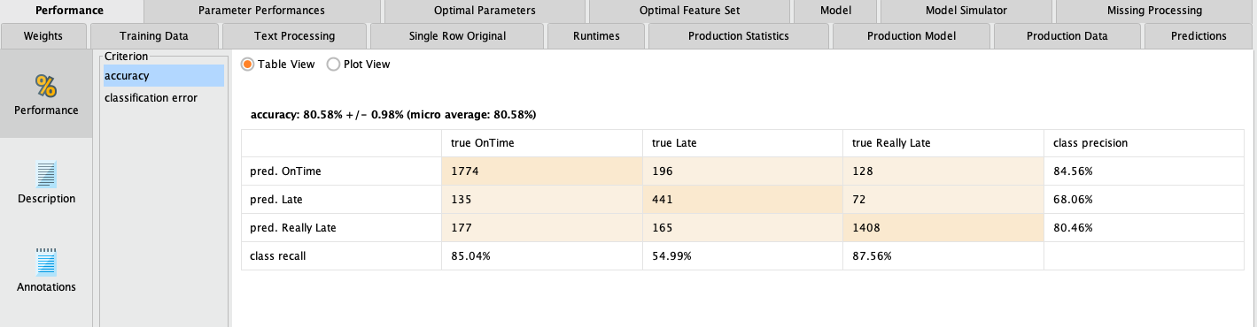
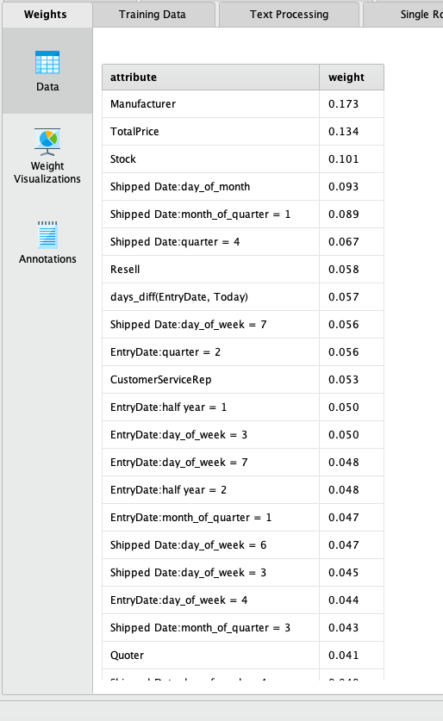
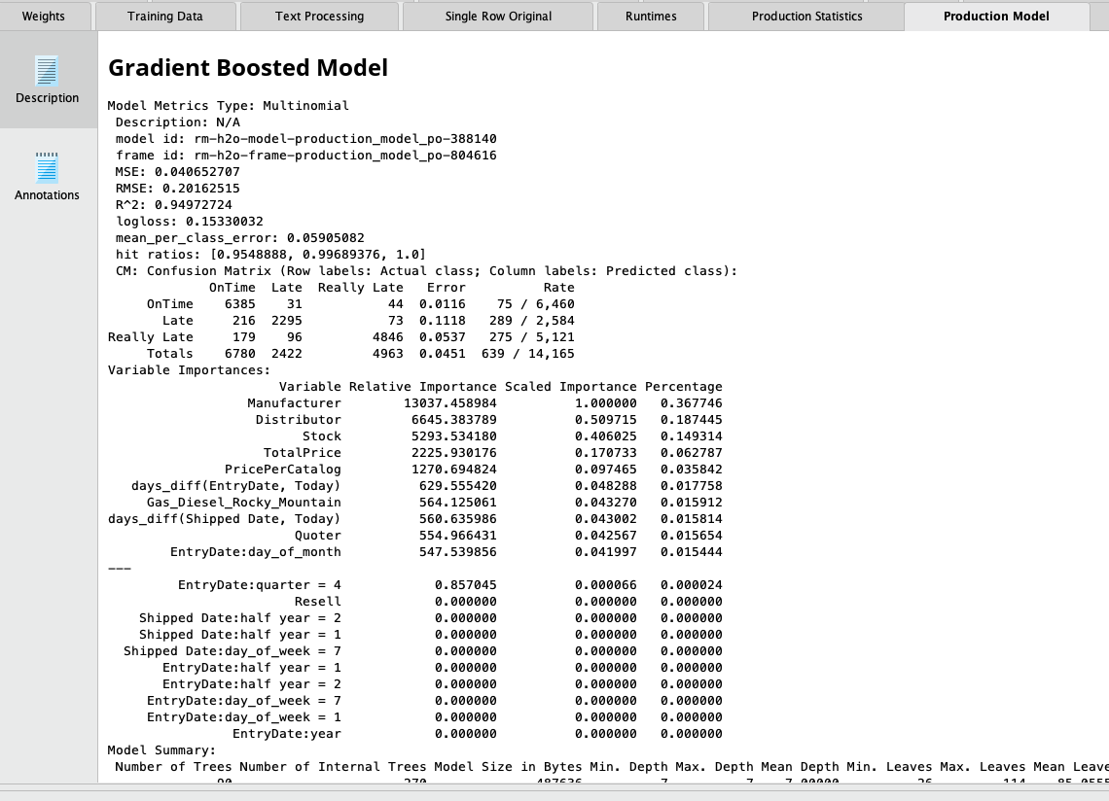
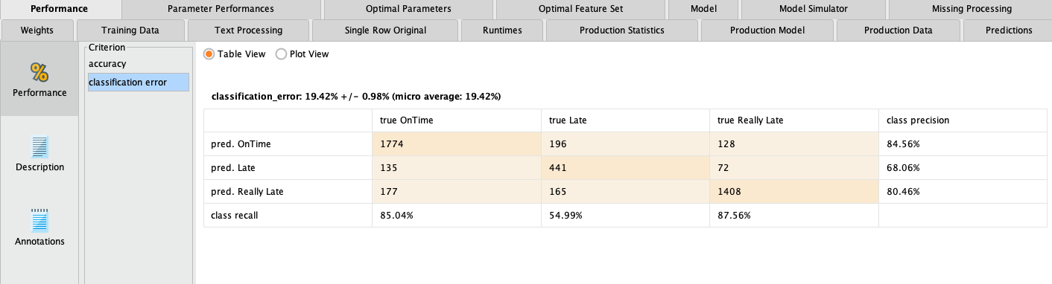
Summary from Gradient Boost Model

Slide 10
Future Work
Gather longer period of data of the gas prices, COVID-19, and weather
Perform and compare analysis for data from Oasis Sales Software for different years
Test to see if the temperature or severe weather has any effect on delivery dates
Narrow down gas prices to exact location
Perform analysis for a wider range of manufacturers to test accuracy of the team’s model
Compare prediction date estimate for years where there wasn’t a pandemic
Notes:
Gather longer periods of data from gas prices, COVID-19, and weather for more extensive analysis of the private company’s dataset.
Perform and compare analysis for different years of the gas prices, COVID-19, weather, and the private company’s data.
Narrow down gas prices to exact location of shipping dates to get more centralized data.
Perform analysis for wider range of manufacturers to test accuracy of the team’s model.
Test to see if the temperature or severe weather of shipping location has any effect on delivery dates.
For the COVID-19 it will be critical to compare prediction date estimates for years where the virus didn’t exist yet to make predictions for when vaccinations are administered to the public.

Slide 11

Question & Answer

